Slide 1
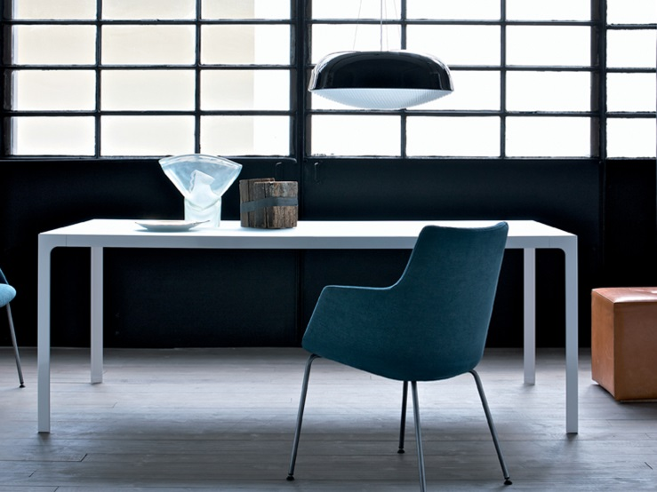
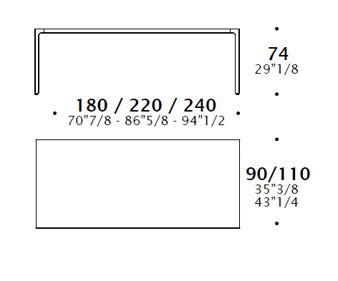
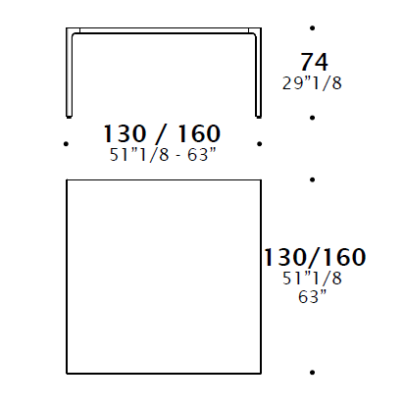
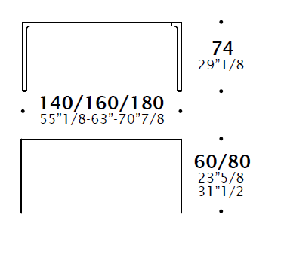
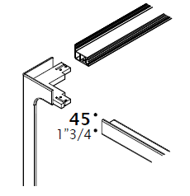
Technical data MORE Estel design
Article: MORE 45 TABLE
A table that is transformed into a system, that adapts to transversal use, interfacing with any environment, from the dining room to the living room, from the home desk to the office desk, from meeting rooms to the executive offices.
Its structure allows you to create extremely customized and flexible accessories.
TECHNICAL CHARACTERISTICS
Support structure consisting of metal legs (metal varnished) that are inserted into the horizontal profiles with a fluid and measured arch.
The tops are surrounded by a flush fit metal frame, available in different finishes (lacquered, veneer and glass).
DIMENSIONS
FINISHES
Metal structure: Glossy Nichel Black, Chromed , Matt Bronze, Matt Brass.
Varnished structure: White Snow, Titanium, Grey Night.
Laminate top: White Snow
Lacquered Top: White Snow, Night Grey, Titanium
Veneer Top: Thermo Treated Oak, Canaletto Walnut
Glass Top: Transparent glass, Back-lacquered etched Glass
Top: Saddle Leather ( see sample collection)
Rectangular table Square table Desk Structure (45mm profile)

Slide 2
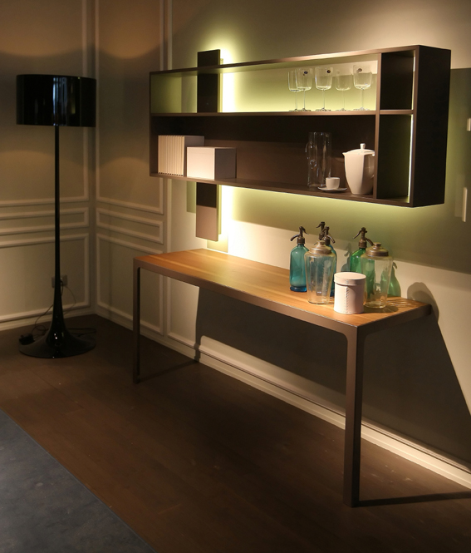
Technical data MORE Estel design
Article: MORE 45 CONSOLLE
A table that is transformed into a system, that adapts to transversal use, interfacing with any environment, from the dining room to the living room, from the home desk to the office desk, from meeting rooms to the executive offices.
Its structure allows you to create extremely customized and flexible accessories.
TECHNICAL CHARACTERISTICS
Support structure consisting of metal legs (metal varnished) that are inserted into the horizontal profiles with a fluid and measured arch.
The tops are surrounded by a flush fit metal frame, available in different finishes (lacquered, veneer and glass).
DIMENSIONS
FINISHES
Metal structure: Glossy Nichel Black, Chromed , Matt Bronze, Matt Brass.
Varnished structure: White Snow, Titanium, Grey Night.
Laminate top: White Snow
Lacquered Top: White Snow, Night Grey, Titanium
Veneer Top: Thermo Treated Oak, Canaletto Walnut
Glass Top: Transparent glass, Back-lacquered etched Glass
Top: Saddle Leather ( see sample collection)
Consolle Structure (45mm profile)

Slide 3
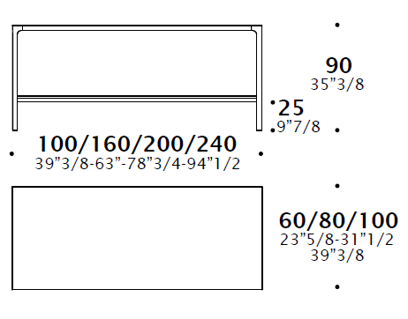
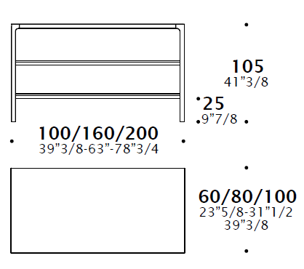
Technical data MORE Estel design
Article: MORE 45 TABLE
A table that is transformed into a system, that adapts to transversal use, interfacing with any environment, from the dining room to the living room, from the home desk to the office desk, from meeting rooms to the executive offices.
Its structure allows you to create extremely customized and flexible accessories.
TECHNICAL CHARACTERISTICS
Support structure consisting of metal legs (metal varnished) that are inserted into the horizontal profiles with a fluid and measured arch.
The tops are surrounded by a flush fit metal frame, available in different finishes (lacquered, veneer and glass).
DIMENSIONS
FINISHES
Metal structure: Glossy Nichel Black, Chromed , Matt Bronze, Matt Brass.
Varnished structure: White Snow, Titanium, Grey Night.
Laminate top: White Snow
Lacquered Top: White Snow, Night Grey, Titanium
Veneer Top: Thermo Treated Oak, Canaletto Walnut
Glass Top: Transparent glass, Back-lacquered etched Glass
Top: Saddle Leather ( see sample collection)
H90 High table H105 High table Structure (45mm profile)

Slide 4
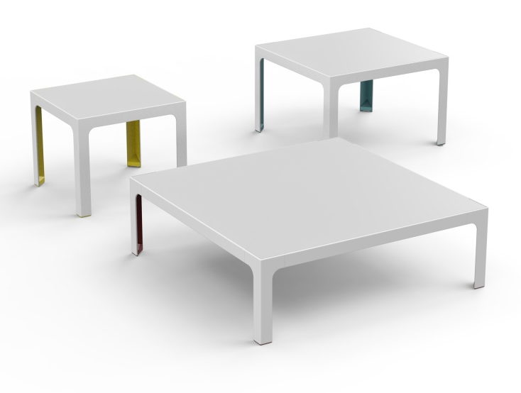
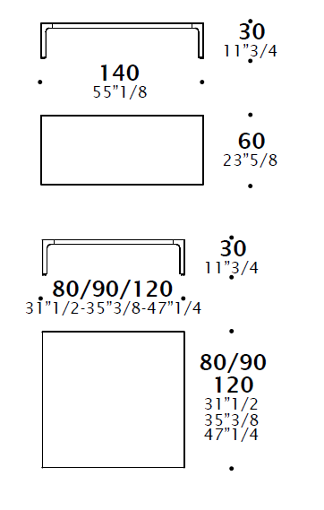
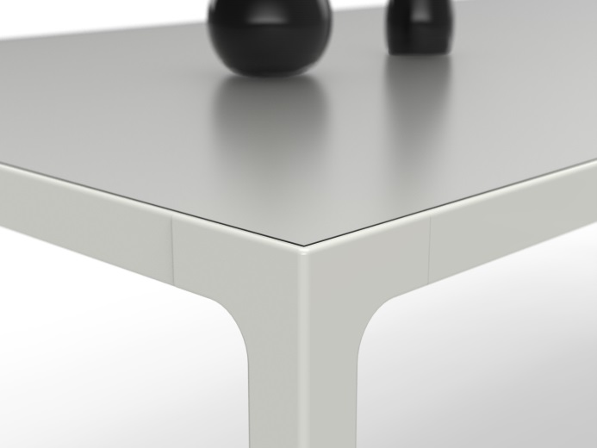
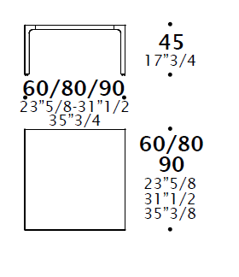
Technical data MORE Estel design
Article: MORE COFFEE TABLE
A coffe table that adapts to transversal use, interfacing with any environment, from the dining room to the living room, from meeting rooms to the executive offices.
Its structure allows you to create extremely customized and flexible accessories.
TECHNICAL CHARACTERISTICS
Support structure consisting of metal legs (metal varnished) that are inserted into the horizontal profiles with a fluid and measured arch.
The tops are surrounded by a flush fit metal frame, available in different finishes (lacquered, veneer and glass).
DIMENSIONS
FINISHES
Metal structure: Glossy Nichel Black, Chromed , Matt Bronze, Matt Brass.
Varnished structure: White Snow, Titanium, Grey Night.
Laminate top: White Snow
Lacquered Top: White Snow, Night Grey, Titanium
Veneer Top: Thermo Treated Oak, Canaletto Walnut
Glass Top: Transparent glass, Back-lacquered etched Glass
Top: Saddle Leather ( see sample collection)
H45 Coffee table H30 Coffee table

